Slide 1

7023T
Advanced Database Systems
Session 06
Dimensional Modelling 2
This presentation is based on Michael A. Fudge, Jr.

Slide 2
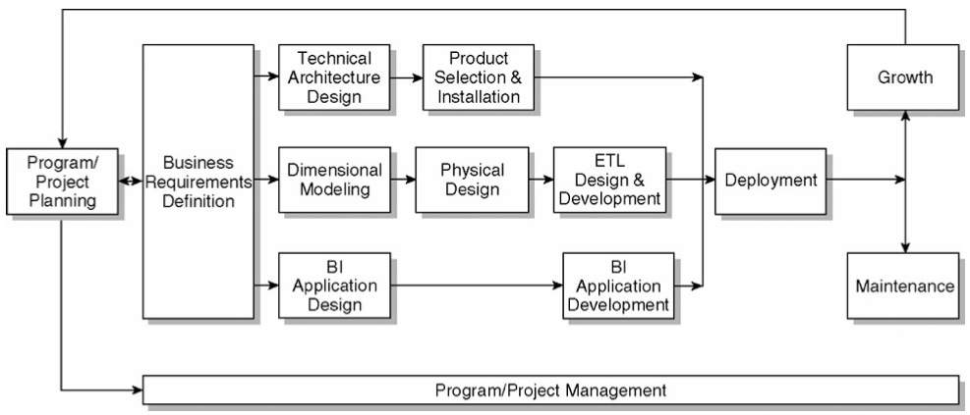
The Kimball Lifecycle Diagram

Slide 3
Enterprise Bus Architecture
Requirements are gathered and represented in a form of Enterprise Data Warehouse Bus Matrix
Each row corresponds to a business/process
Each column corresponds to a dimension of the business
Each column is a conformed dimension
Enterprise Data Warehouse Bus Matrix documents the overall data architecture for DW/BI system
Notes:
The task of planning the enterprise DW/BI data architecture is daunting. The DW/BI manager is supposed to understand the content and location of the most complicated asset owned by the enterprise: the source data. Somehow the DW/BI manager is supposed to become an authority on exactly what is contained in all those legacy mainframe, ERP, web server, application server, and other business systems. Every data element in every system must be understood. The DW/BI manager must be able to retrieve any requested element of data and, if necessary, clean it up and correct it. On the other hand, the DW/BI manager is supposed to understand exactly what keeps management awake at night. The DW/BI system is expected to contain exactly the data needed to answer the burning questions du jour.
The answer to this dilemma is to start with a quick and succinct effort that defines the overall enterprise DW/BI data architecture. The enterprise data warehouse bus matrix is the overall data architecture for the DW/BI system. The matrix delivers the big picture perspective, regardless of database or technology preferences, while also identifying reasonably manageable development efforts.

Slide 4
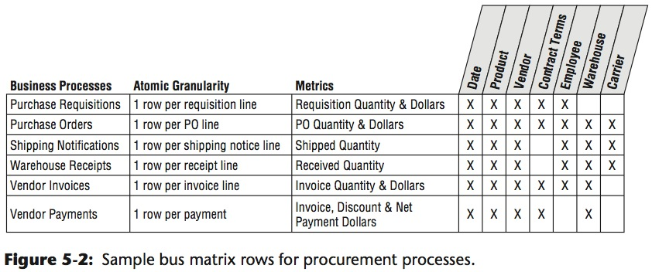
Enterprise Bus Architecture Matrix
Conformed dimensions

Slide 5
Enterprise Bus Architecture Matrix
Possible Problems:
Level of details for each column and row in the matrix
Row-related
Listing departments/imitating organizational chart instead of business processes
Listing reports and analytics related to business process instead of the business process itself
Ex. Shipping orders business process supports various analytics such as customer ranking, sales rep performance, product movement analyses

Slide 6
Enterprise Bus Architecture Matrix
Possible Problems (Cont):
Column-related
Generalized columns/dimensions
Example: “Entity” column is too general as it includes employees, suppliers, contractors, vendors, customers
Too many columns related to the same dimension
Worst case when each attribute is listed separately
Example: Product, Product Group, LOB* are all related to the Product dimension and should be listed as one.
Notes:
LOB: Line of Bussiness

Slide 7
Date/Time Dimensions
Standard date dimension table at a daily grain
Rationale: remove association with calendar from BI applications
Use numeric surrogate keys for date dimension tables
Date Dimension
Date key pk
Calendar Date
Calendar Month
Calendar Day
Calendar Quarter
Calendar Half year
Calendar Year
Fiscal Quarter
Fiscal Year
…

Slide 8

Date/Time Dimensions
Time of day should be treated as dimension only if there are meaningful textual descriptions for periods within the day
Example; lunch hour, rush hours, etc.
Otherwise, time of day needs to be represented as a simple non-additive fact or a date/timestamp
Notes:
Calendar navigation should be driven through the date dimension table, not through hard coded application logic.

Slide 9

Date/Timestamp
Used in the fact table to support precise time interval calculated across fact rows
Calculations to be performed by ETL system
Example: elapsed time between original claim date and first payment date
Notes:
If the business needs to calculate and analyze the lag between two specific date/timestamps, then these calculations should be performed in the ETL system and populated as facts for fast and simple direct user access.

Slide 10
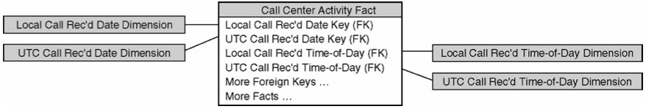
Multiple Time Zones
Express time in coordinated universal time (UTC)
Additionally, may be expressed in local time
Other options: use a single time zone (for example, ET) to express all times in this zone

Slide 11
Degenerate Dimensions
Occur in transaction fact tables that have a natural parent-child structure
Key remains the only attribute left after other attributes got separated into dimensions
Key should be the actual transaction number
Stored in a fact table - do not create a corresponding dimension table

Slide 12
Degenerate Dimensions: example
DIM CUSTOMER
Customer key
customer id
customer lname
customer fname
ORDERS TRANSACTIONS
order#
customer id
customer lname
customer fname
shipto street address
shipto city
shipto state
shipto zip
order total amount
discount amount
net order amount
payment amount
order date
ORDERS FACTS
customer key
shipto address key
order date key
order total amount
discount amount
net order amount
payment amount
order#
DIM SHIPTO ADDRESS
Shipto address key
shipto street address
shipto city
shipto state
shipto zip
DIM Order Date
Order date key
Calendar date
Calendar month
…

Slide 13

Slowly Changing Dimensions
Dimension table attributes change infrequently
Mini-dimensions
Separating more frequently changing attributes into their own separate dimension table, a.k.a. mini-dimension¹
3 types of handling slowly changing dimensions
Overwrite the dimension attribute
Add a new dimension row
Add a new dimension attribute
Notes:
1

Slide 14
Mini Dimensions
Frequently changed attributes

Slide 15

Overwrite the dimension attribute
New values overwrite old ones
No history is kept
Problems occur if data was previously aggregated based on old values
Will not match ad-hoc aggregations based on new values
Previous aggregations need to be updated to keep aggregated data in-sync.

Slide 16
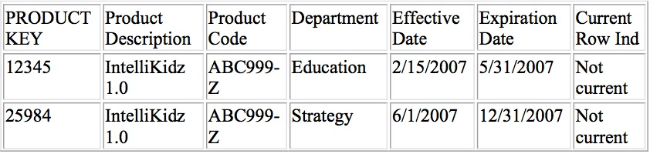
Add a new dimension row
Most popular technique
New row with new surrogate PK is inserted into dimension table to reflect new attribute values
Both, old and new values are stored along with effective and expiration dates, and the current row indicator
Notes:
The type 2 approach requires the use of a surrogate key to uniquely identify the new profile

Slide 17

Add a new dimension attribute
Used infrequently
A new column is added to the dimension table
Old value is recorded in a “prior” attribute column
New value is recorded in the existing column
All BI applications transparently use the new attribute
Queries can be written to access values stored in the “prior“ attribute column
Notes:
This allows users to choose between the two versions at will.
If a dimension attribute changes with a predictable rhythm, such as annually, and the business needs to summarize facts based on any historical value of the attribute, not just the historically accurate and current as we've primarily been discussing, you could have a series of type 3 attributes in the dimension.

Slide 18
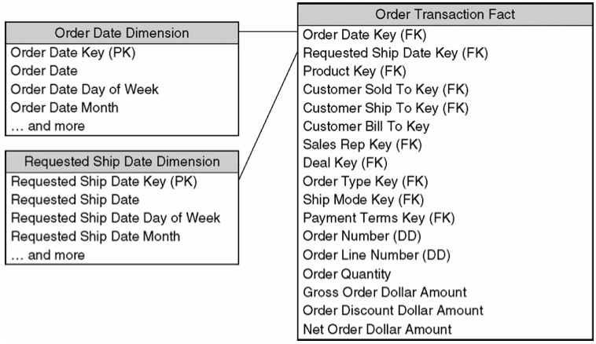
Role-playing Dimensions
Same physical dimension table plays different logical role in a dimension model
Example: multiple date dimensions
Notes:
Each date foreign key in the fact table points to a specific date dimension table, as
shown in Figure. You can't join these multiple foreign keys to the same table
because SQL would interpret the two-way simultaneous join as requiring the dates to
be the same, which isn't very likely.

Slide 19
Role-playing Dimensions
Other examples:
Customer (ship to, bill to, sold to)
Facility or port (origin, destination)
Provider (referring, performing)
Stored in the same physical table but presented in a separately-labeled view
Implemented using views or aliases depending on the database platform

Slide 20
“Junk” Dimensions
Miscellaneous flags and text attributes that cannot be placed into one of existing dimension tables
Alternatives:
Leave them in the fact table
Eliminate them*
Store them in a “junk” dimension
Store as unique combinations
Data profiling is useful in identifying junk dimension candidates
Notes:
* If the flags and text attributes are incomprehensible, inconsistently populated, or only of operational significance, they should be left out.

Slide 21
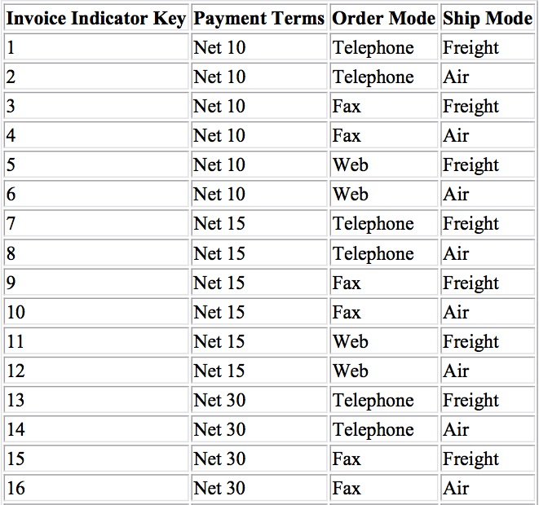
“Junk” Dimension Example

Slide 22
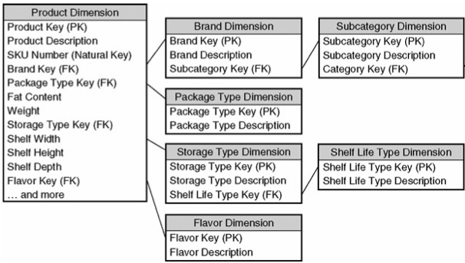
Snowflaking
Occurs when dimension tables are normalized
Increases complexity for users
Decreases performance
Notes:
Dimensions are snowflaked when the redundant attributes and decodes are removed to separate tables and linked back into the original table with artificial keys. In other words, a snowflaked dimension is normalized.
Generally, snowflaking is not recommended for your dimensional models because it almost always makes the user presentation more complex and less legible.

Slide 23
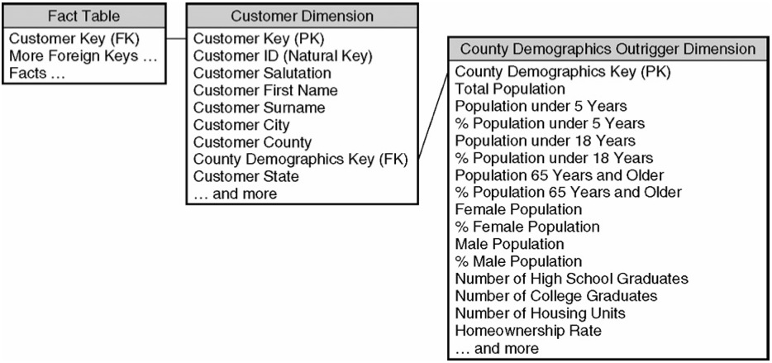
Outrigger Dimensions
Look like a beginning of a snowflake
Example:
Large number of attributes
Different grain*
Different update frequency**
Notes:
County demographic data consists of a label, population count, and population percentage for 50 different demographic groupings, so there are 150 attributes.
* Per customer or county
** Update frequency of demographic data would be more frequent than customer data

Slide 24
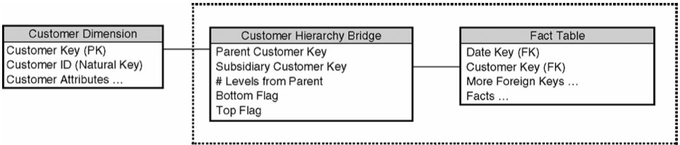
Bridge Tables: Variable-depth Hierarchies
Should be used only when absolutely necessary
Negatively affect usability
Decrease performance
Example:

Slide 25
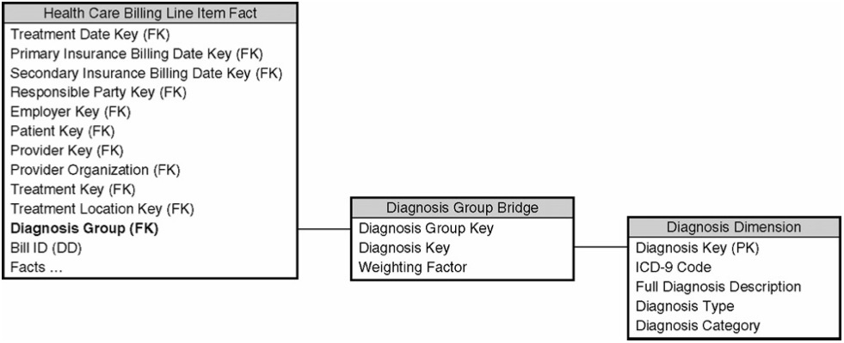
Bridge Tables: Many-Valued Dimensions
Each fact measurement can be associated with multiple dimension values
Example: patients in a hospital often have more than one diagnosis

Slide 26

3 Fundamental Fact Table Grains
Transaction
One row per transaction/line of transaction
Rows are inserted into fact tables only when a transaction activity occurs
Periodic snapshot
Accumulating snapshot

Slide 27
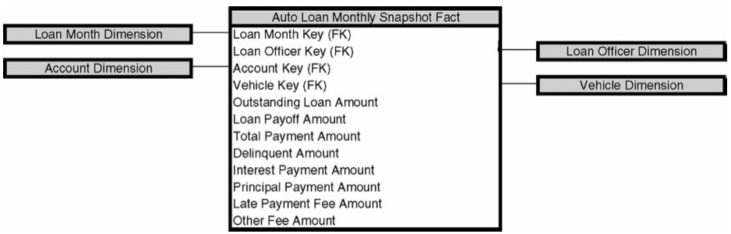
Periodic snapshot
At predetermined intervals snapshots of the same level of details are taken and stacked consecutively in the fact table
Example: most financial reports, bank account value
Complements detailed transaction facts but not substitutes them
Share the same conformed dimensions but have less dimensions

Slide 28
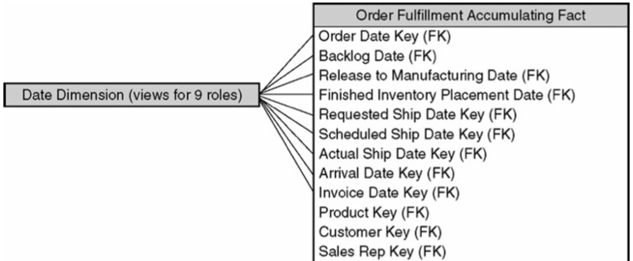
Accumulating snapshot
Less frequently used
Have multiple date FK that correspond to each milestone in the workflow
Lots of N/A or Unknown fields when a row is originally inserted
Requires a special row in date dimension table as discussed earlier
Notes:
Let's assume XYZ Company is able to manufacture 10,000 widgets per day. On Monday morning, the company receives an order for 50,000 widgets. Given the company's daily production capacity, XYZ Company will end Monday with a backlog of 40,000 widgets. If each widget sells for $1, XYZ Company would report a $40,000 backlog.
Backlogs are usually measured in dollars and generally occur when there is a shortage of labor or supplies. Building products to each customer's specifications may also lead to backlogs.

Slide 29

Facts of Different Granularity
A single fact table cannot have facts with different granularity
All measurements must be in the same level of details
Example:
Measurements are captured for each line order except for the shipping charge which is for the entire order
Solutions:
Allocating higher level facts to a lower granularity
Create two separate fact table

Slide 30
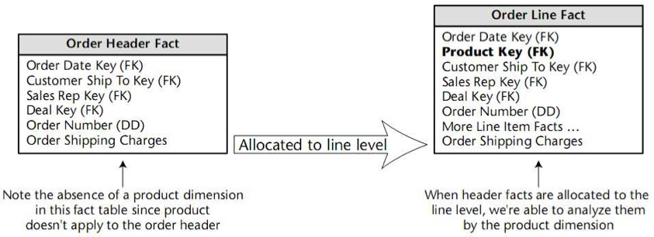
Facts of Different Granularity: Example

Slide 31
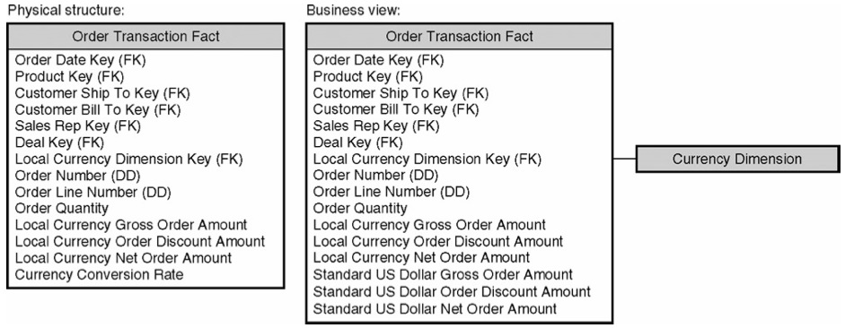
Multiple Currencies and Units of Measures
Measurements are provided in a local currency
Measurements are also converted to a standardized currency or conversion rates must be stored
Similarly, in case of multiple units of measures, conversions to all different units of measure are provided

Slide 32
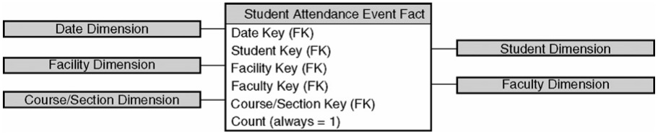
Factless Fact Tables
Business processes that do not generate quantifiable measurements
Example: student attendance
Can be easily converted into traditional fact tables by adding an attribute Count, which is always equal to 1.
Helps to perform aggregations

Slide 33
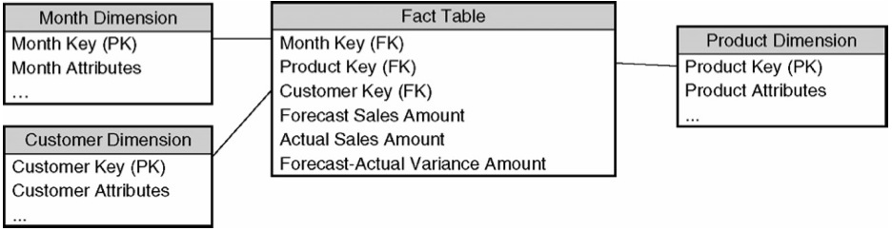
Consolidated Fact Tables
Fact tables populated from different sources may potentially be consolidated into single one
Level of granularity must be the same
Measurements are listed side-by-side
Example: by combining forecast and actual sales amounts, a forecast/actual sales variance amount can be easily calculated and stored

Slide 34
Recommendations
Do not take a “report-centric” approach
Do not create a new dimensional model for each slightly different report
Do not create a new dimensional model for each department for data from the same source
Create dimensional models with the finest level of granularity (atomic data)
Flexible and independent of a specific business question/report
Scalable
Use conformed dimensions
Ease integration efforts
Make ETL process structured
Avoid chaos when integrating multiple data marts

